Slide 1

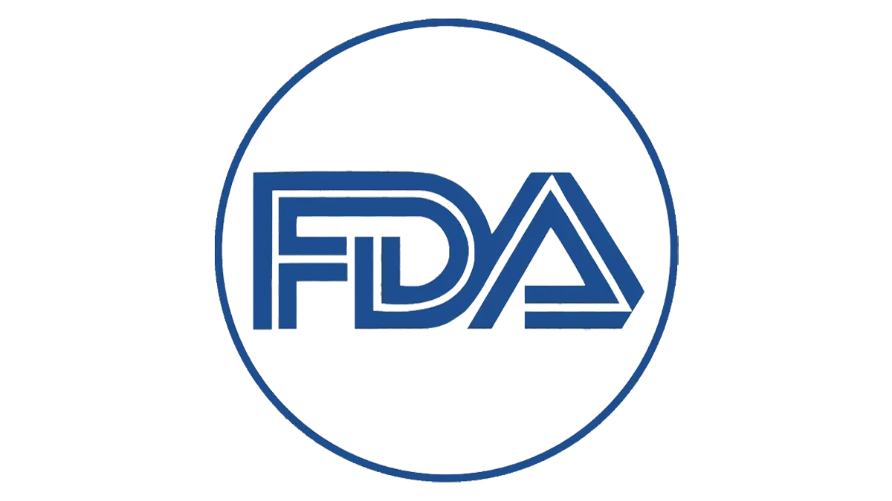
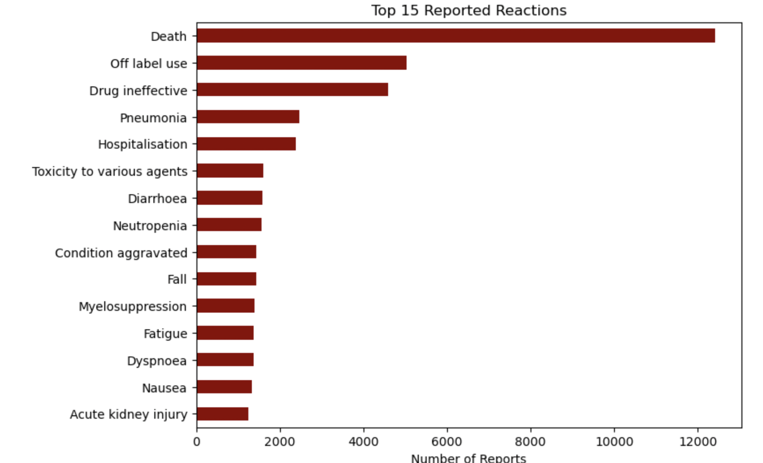
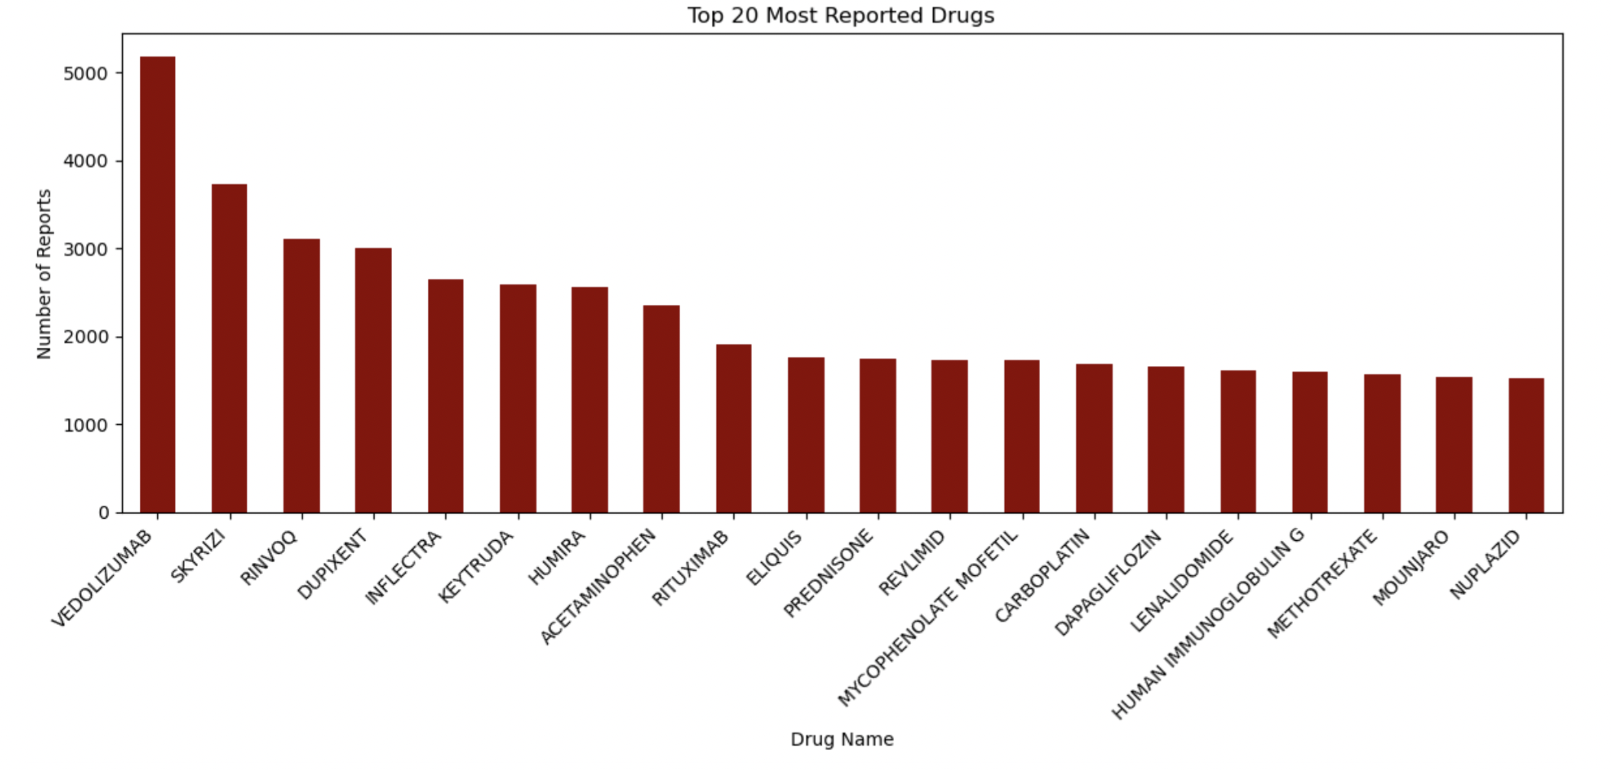
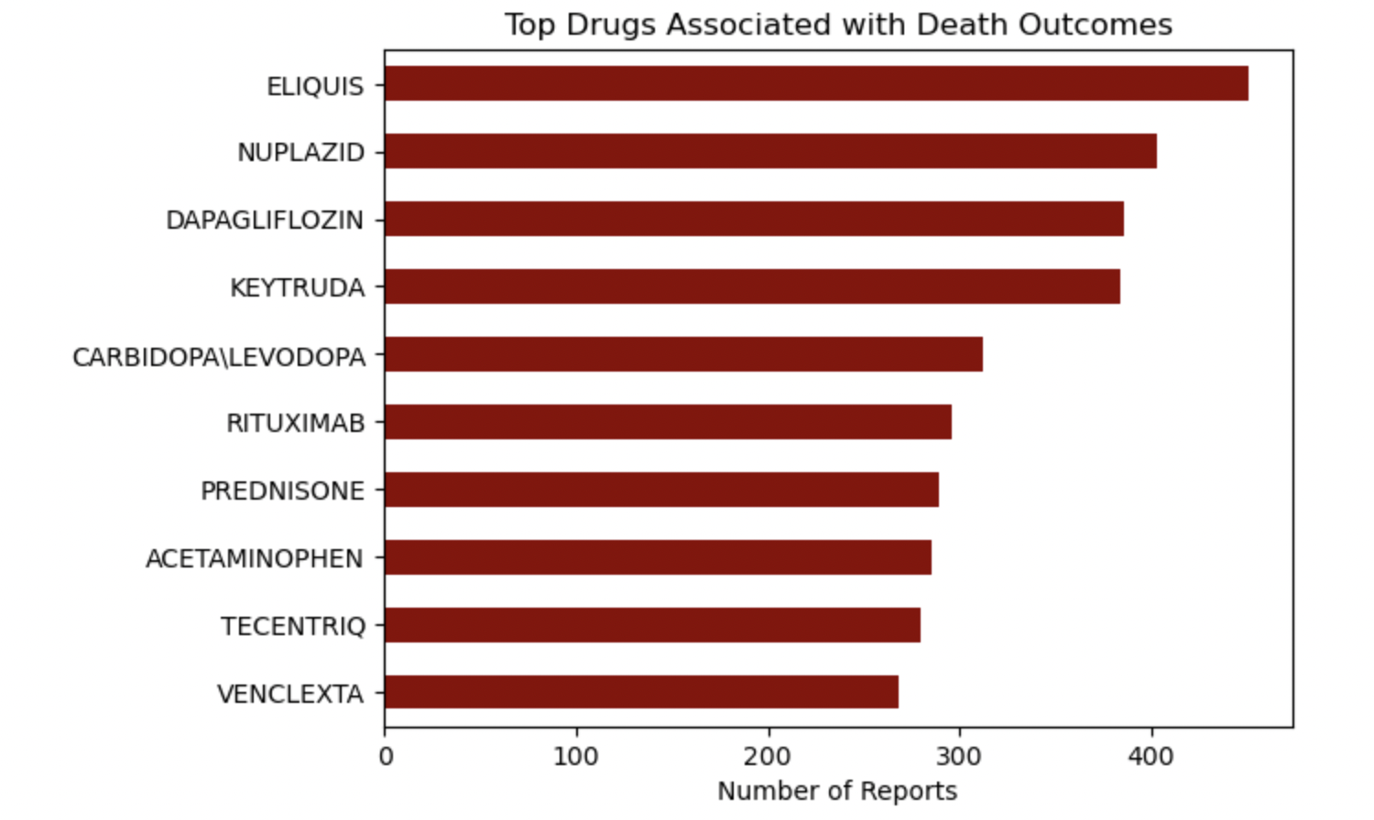
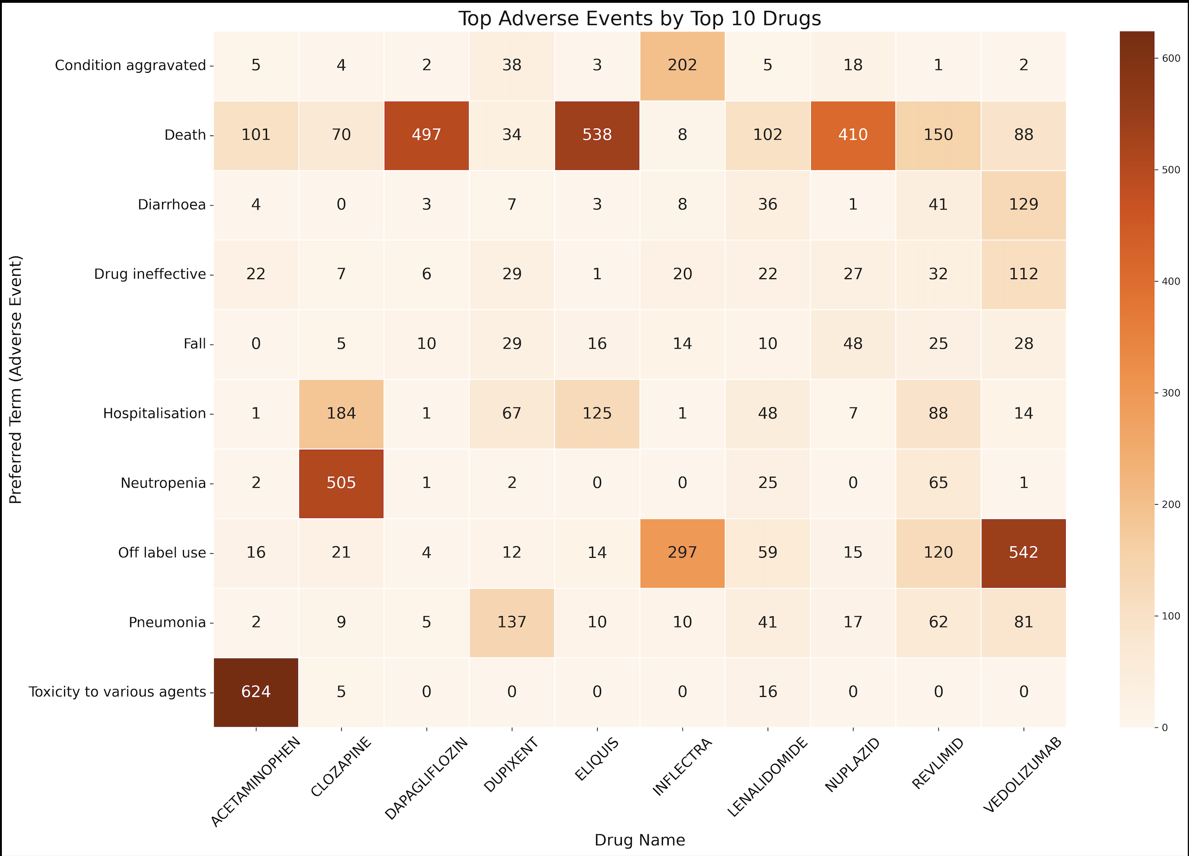
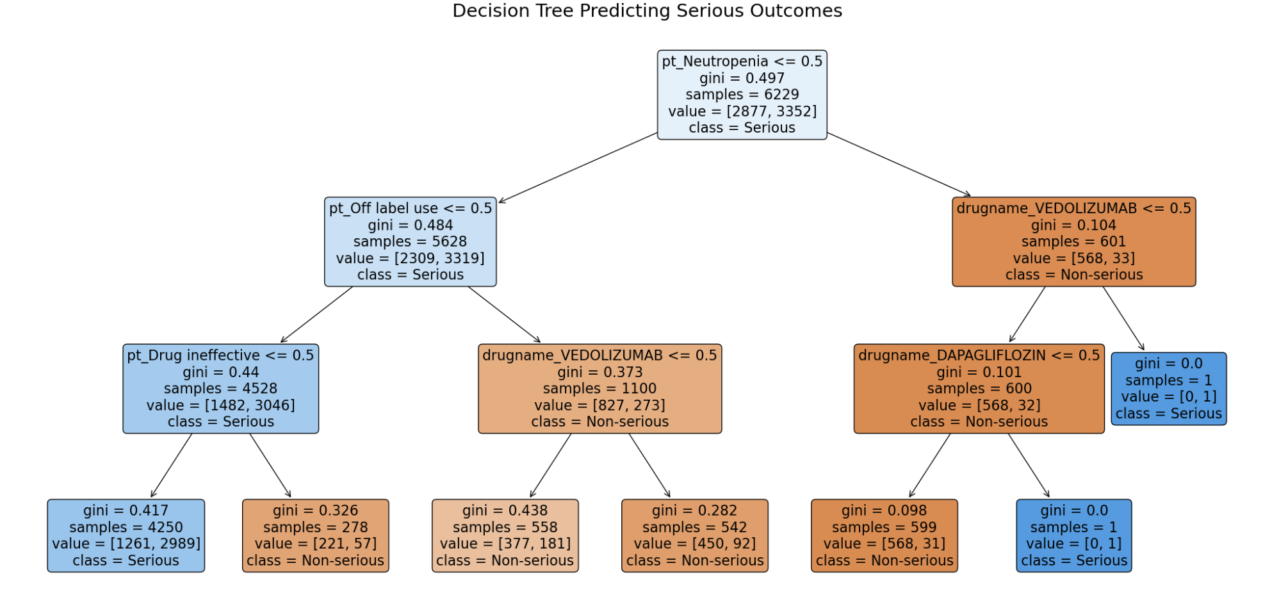


FDA Adverse Reactions Analysis
Chloe Schnydman, Rahma Semma, Department of Data Analytics, Dickinson College
Introduction
The FDA’s FAERS (FDA Adverse Event Reporting System) database collects voluntary reports of adverse drug reactions from healthcare providers, patients, and manufacturers. It serves as a critical resource for detecting new safety concerns, understanding drug risks, and making regulatory decisions.
The purpose of this project is to analyze adverse drug reactions in the fourth quarter of 2024. This analysis aims to:
Identify patterns and trends in adverse reactions related to various drugs
Determine which drugs are associated with severe or common adverse reactions
Examine demographic factors that may influence the likelihood or severity of reported reactions
Provide insights for healthcare professionals and regulatory agencies to improve drug safety and post-market surveillance.
Results
Conclusions
In our bar plots, we observed that a handful of drugs, such as Eliquis and Humira, were responsible for a disproportionate number of adverse event reports, suggesting their widespread use and potential safety concerns. Among reported reactions, “Death,” “Off label use,” and “Drug ineffective” stood out not only in frequency but also in severity, emphasizing the importance of monitoring treatment effectiveness and proper usage.
By comparing drugs with death-specific reports, we identified medications like Nuplazid and Dapagliflozin that may warrant closer post-market evaluation. Our heatmap analysis further revealed consistent overlaps between top drugs and severe adverse events like “Hospitalization” and “Neutropenia,” suggesting shared high-risk patterns across multiple therapies.
Finally, using a decision tree classifier, we demonstrated that a few adverse event terms could meaningfully separate serious from non-serious cases, offering a transparent tool for early signal detection.
Figure 1: Top 20 Most Reported Drugs
Figure 2: Top 15 Most Reported Reactions
Methods
We analyzed FAERS data by merging adverse outcomes with reported drug and preferred term (PT) codes. Using Python (pandas, seaborn, sci-kit-learn), we visualized the top 10 drugs and adverse events via a heatmap and trained a logistic regression model to evaluate predictors of serious outcomes. We also built a decision tree classifier (max depth = 3) to illustrate how specific PTs and drugs contribute to the classification of serious versus non-serious reports. All data were preprocessed with one-hot encoding, and models were evaluated on interpretability and visual clarity for presentation.
Figure 3: Top Drugs Associated with Death Outcomes
Figure 4: Top Adverse Events by Top 10 Drugs
Literature cited
U.S. Food and Drug Administration. (2025, January 28.). FDA Adverse Event Reporting System (FAERS) Quarterly Data Extract Files. U.S. Department of Health and Human Services. https://fis.fda.gov/extensions/FPD-QDE-FAERS/FPD-QDE-FAERS.html#FOIA.
$∎$ Serious Outcomes:
Death
Hospitalization
$∎$Non-Serious Outcomes:
Life-Threatening
Disability
Congenital Anomaly
Required Intervention
Other Serious
Further information
Figure 5: Decision Tree Predicting Serious Outcomes

